Slide 1
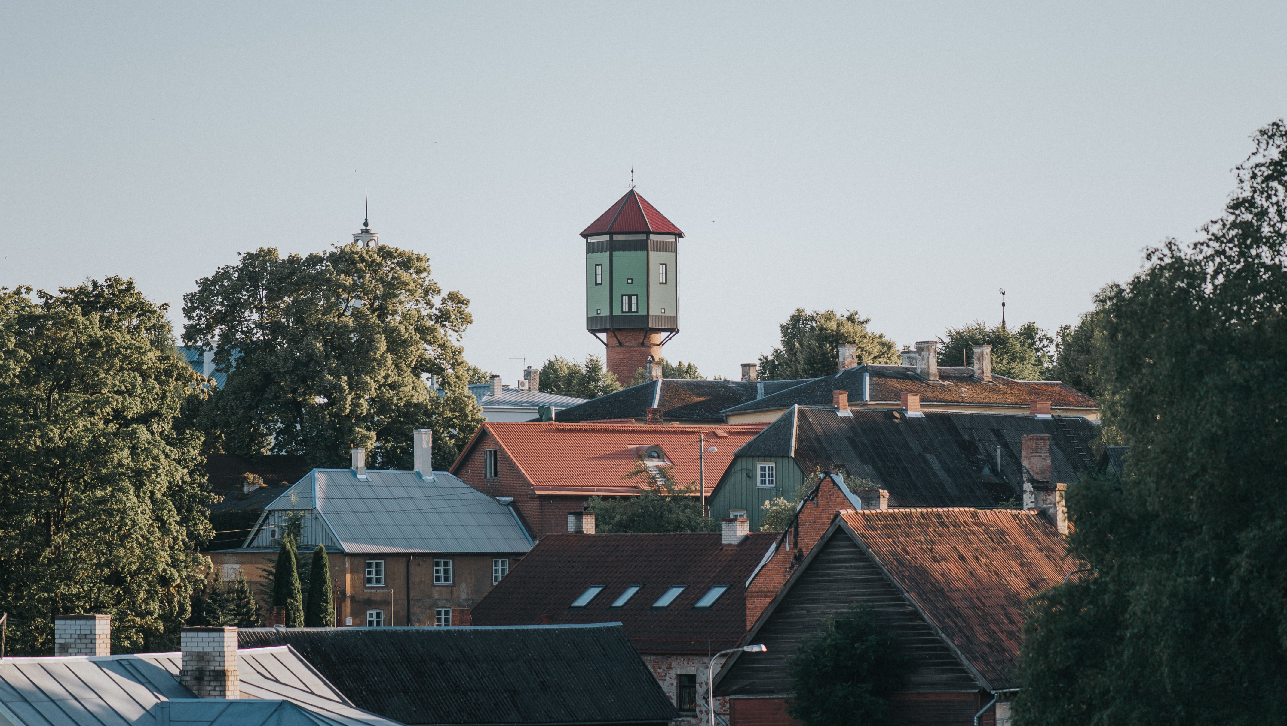
Viljandi 2019

Slide 2
6th largest city in Estonia
Population 17 45 (01.09.2019)
Area: 14.65 km²
Received town charter in 1283
Member of the Hanseatic League since the 14th century

Slide 3
Budget
2019 budget
40,74 million euros

Slide 5
Government
Mayor Madis Timpson (Reform Party)
Chairman of town council
Helir-Valdor Seeder (Pro Patria)

Slide 6
Town council
27 members
Coalition:
Reform Party (8)
Pro Patria (6)
Centre Party (2)
Opposition:
Social Democrats (9)
Conservative People’s Party (2)

Slide 7
Town government
8 members
Mayor Madis Timpson (Ref)
Deputy mayor Kalvi Märtin (Ref) infrastructure and planning
Deputy mayor Janika Gedvil (Isamaa) social work, education and culture
Gunnar Veermäe (Isamaa), Rein Triisa (Ref), Kert Villems (Ref), Gert Elmaste (Isamaa), Karl Õmblus (Centre)

Slide 8
Education

Slide 9
Number of students
3 municipal primary- and middle schools: 1924
1 state upper secondary school: 558
1 special ed. school 85
1 adult high school 300
4 co-curricular schools: 1691
4 kinderkartens: 875
1 University of Tartu Culture Academy: 733
2 private schools and kindergartens: 165

Slide 10
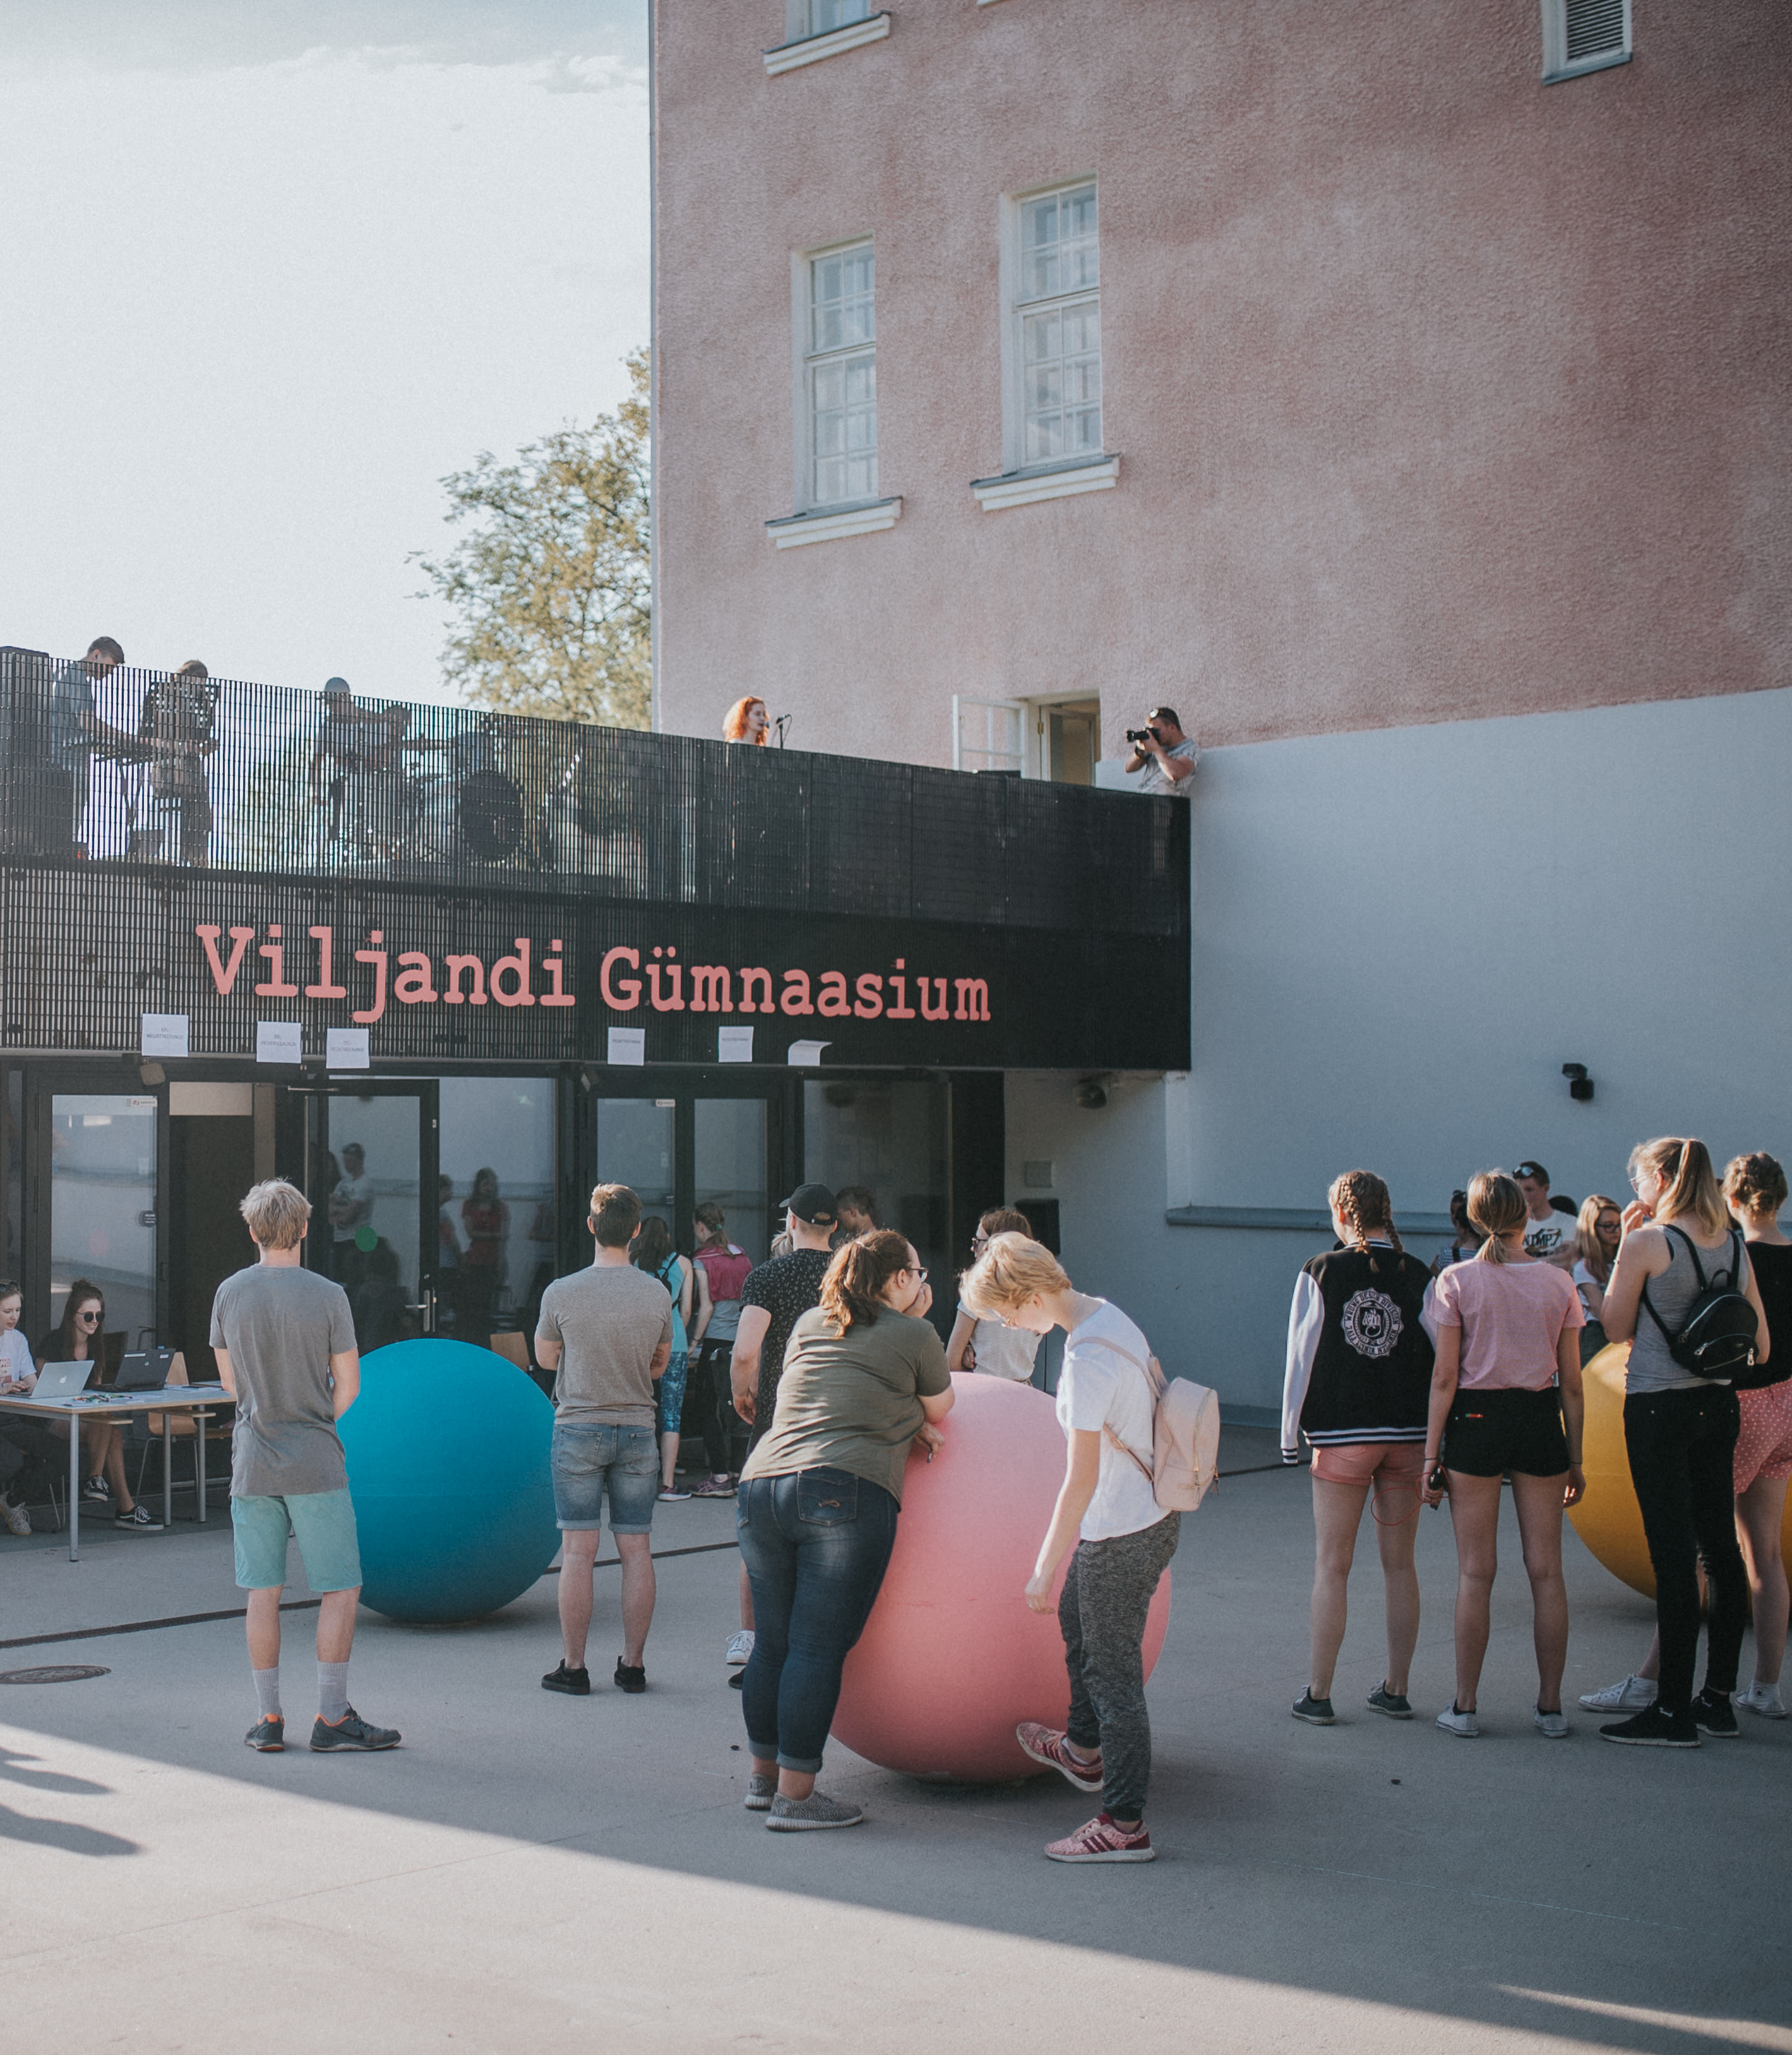
Viljandi Upper Secondary School
Estonia’s first state secondary school
New building finished 2013. aastal
558 students

Slide 11
Economy

Slide 12
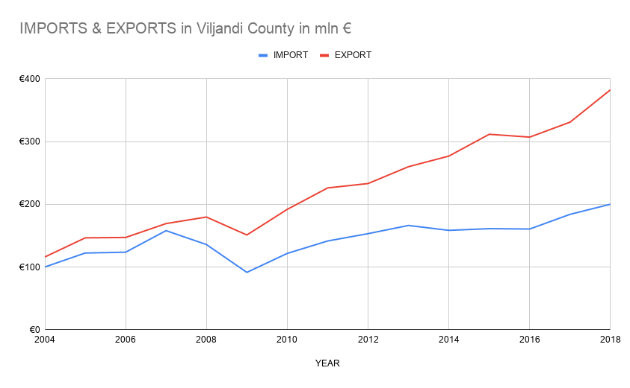
Balance of trade +183 mln €
In 2018
Imports 200 mln €
(631 businesses)
Exports 383 mln €
(310 businesses)
Source: Statistikaamet

Slide 13
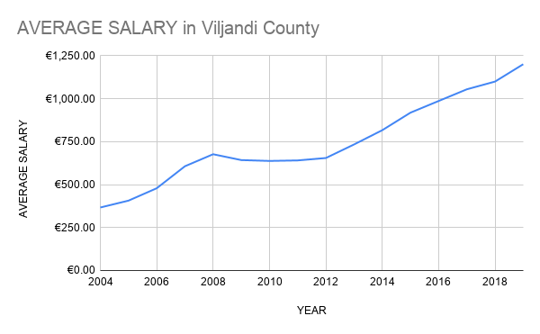
Average salary 1217 euros
II. Q in Viljandi. Source: Statistikaamet

Slide 14
Largest companies
AS Viljandi Aken ja Uks
Produces windows and doors
90% of products exported, mainly to Scandinavia
640+ employees
2018 turnover 89 700 000€
Source: Maksu- ja Tolliamet

Slide 15
Largest companies
Delux OÜ
Produces quilts, pillows, continental beds and mattresses
99% of products exported to more than 30 countries
260+ employees
2018 turnover 32 808 717 €
Source: Maksu- ja Tolliamet

Slide 16
Largest companies (2018)
By number of employees
Viljandi Aken ja Uks AS 633
Viljandi Tarbijate Ühistu 276
Delux Production OÜ 262
Hansa Bussiliinid AS 243
Toom Tekstiil AS 243
Cleveron AS 175
Mivar-Viva AS 166
Kolmeks AS 159
Pesuekspert OÜ 138
VMT Tehased AS 129
Source: Maksu- ja Tolliamet

Slide 17
Success story
Cleveron AS
Produces and develops hi-tech parcel delivery machines
Active in 8 countries including the US and Brazil
175+ employees
2018 turnover 50 615 000 €
Source: Maksu- ja Tolliamet

Slide 18
Culture

Slide 19
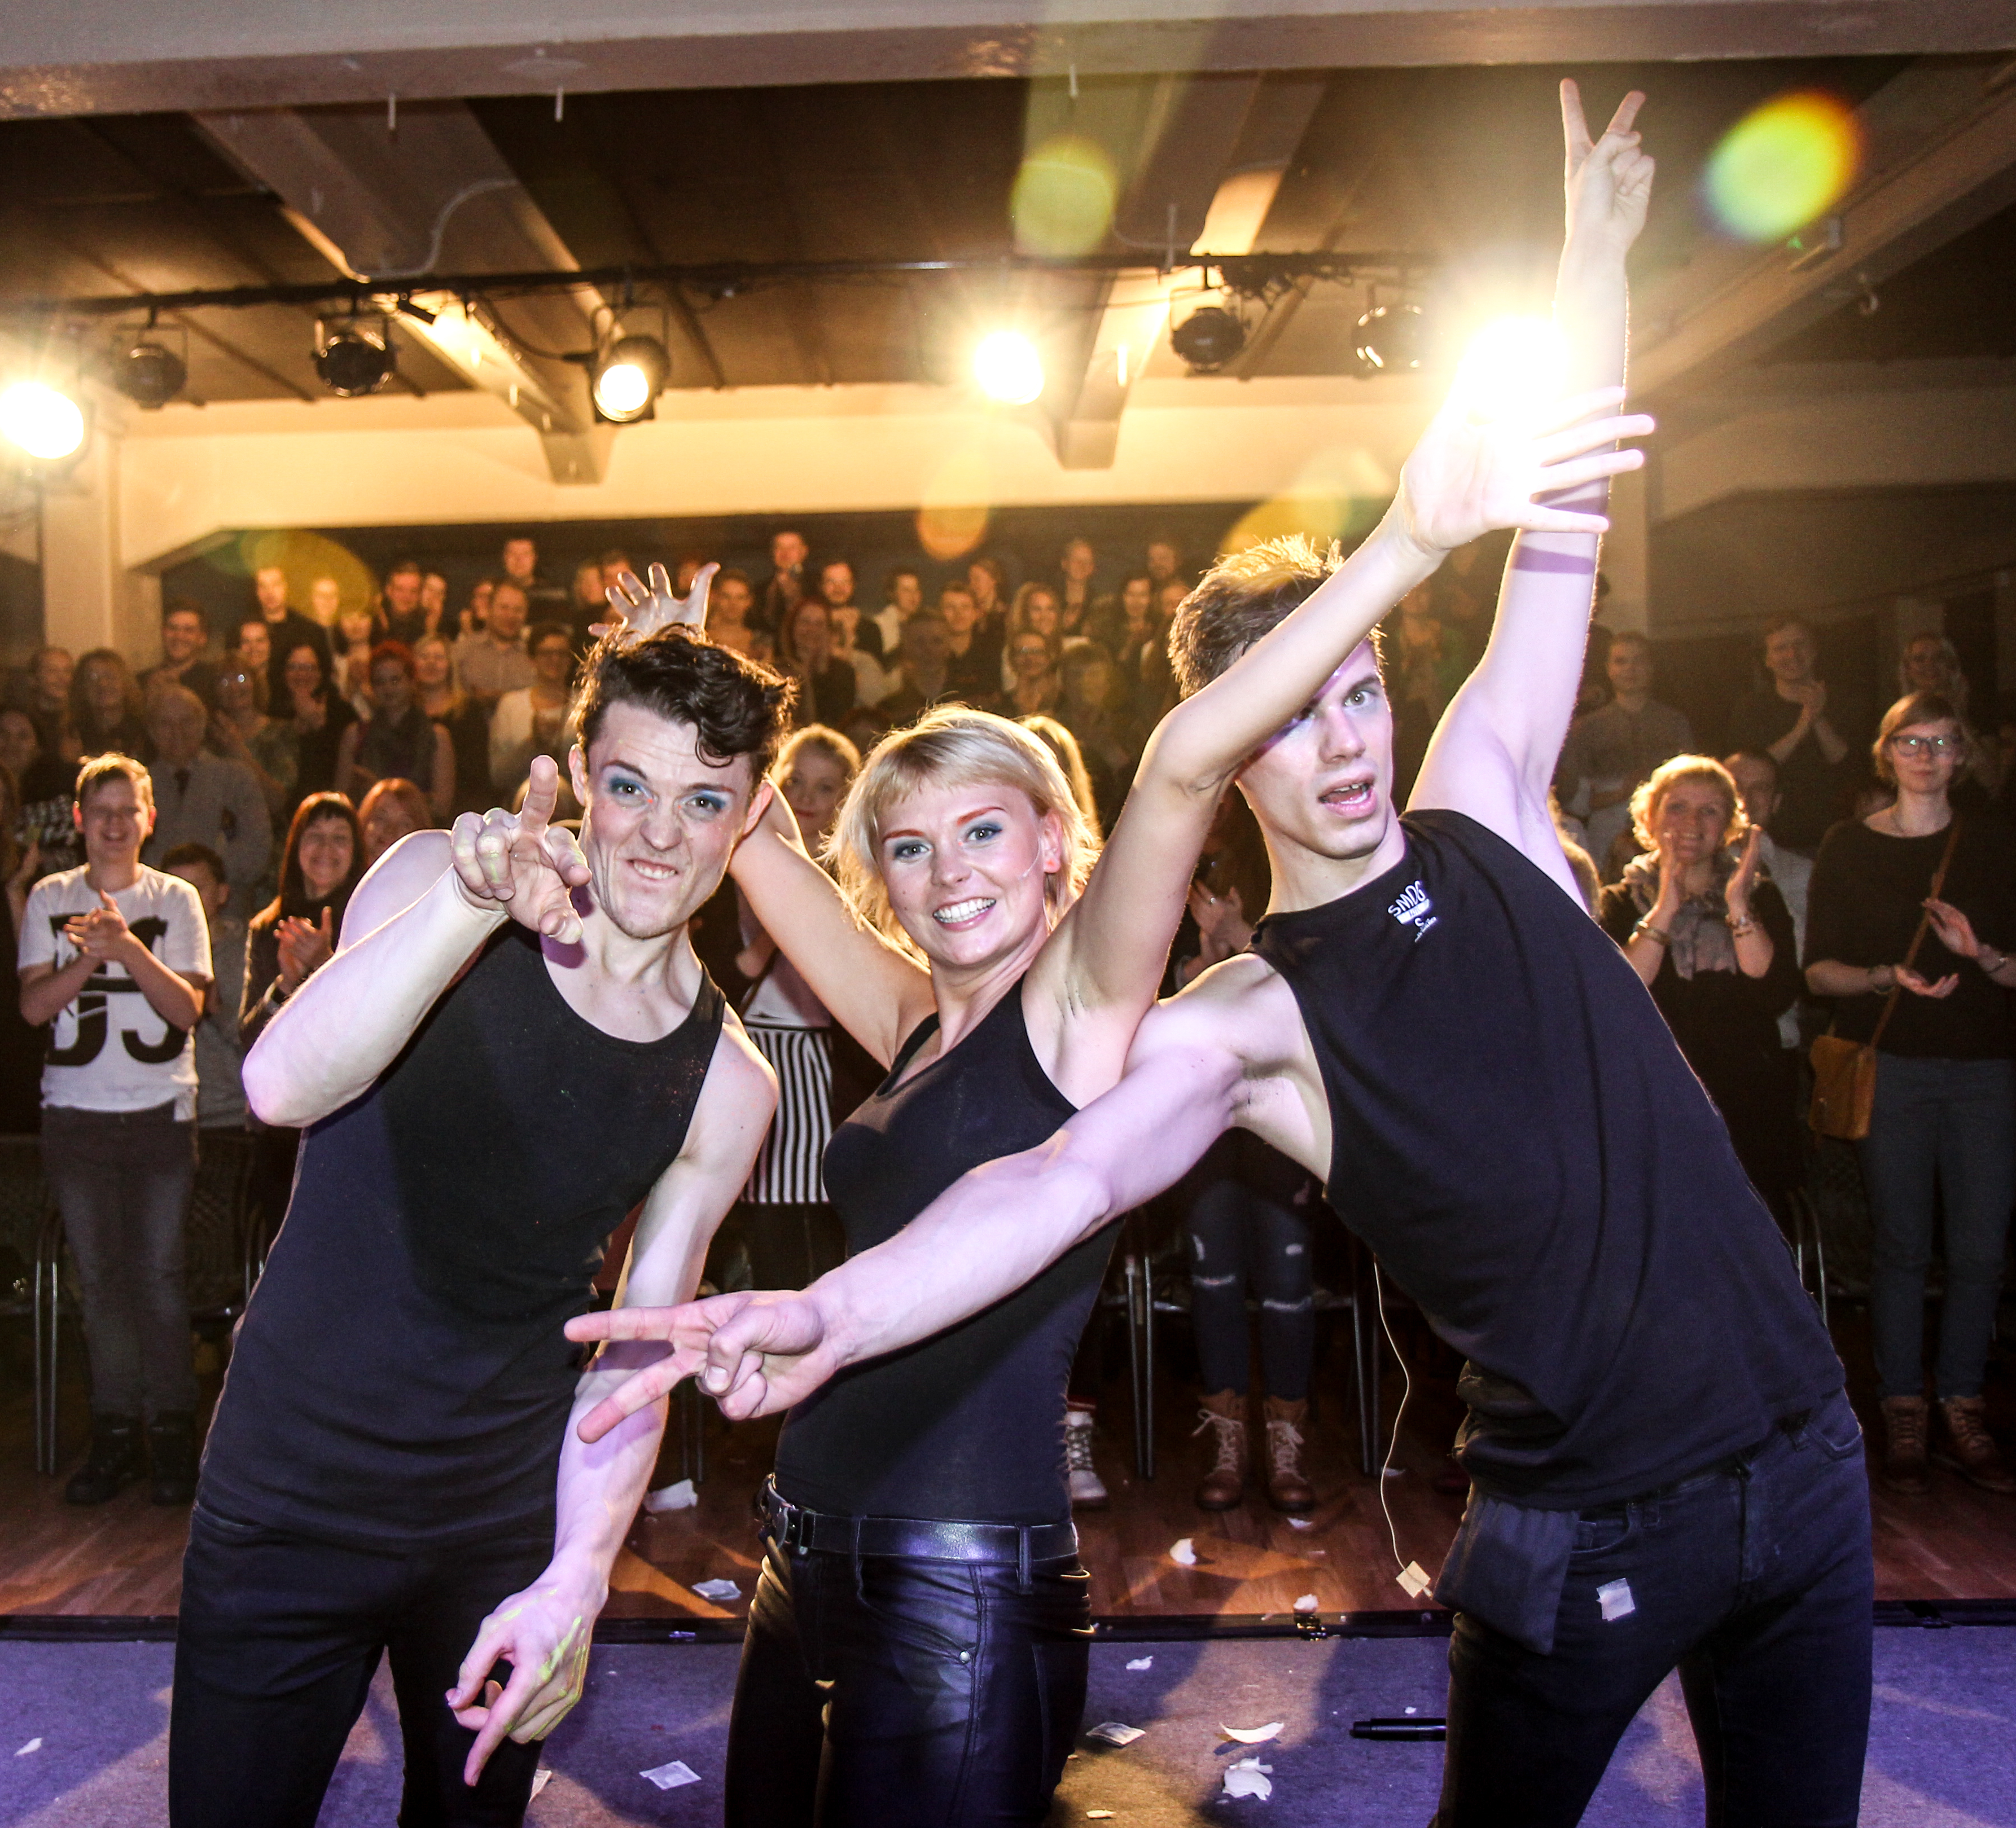
Ugala theatre
In 2018:
279 performances
Over 90 000 visitors

Slide 20
Estonian Traditional Music Centre
Viljandi Folk Music Festival
Events all year round
Education & research

Slide 21
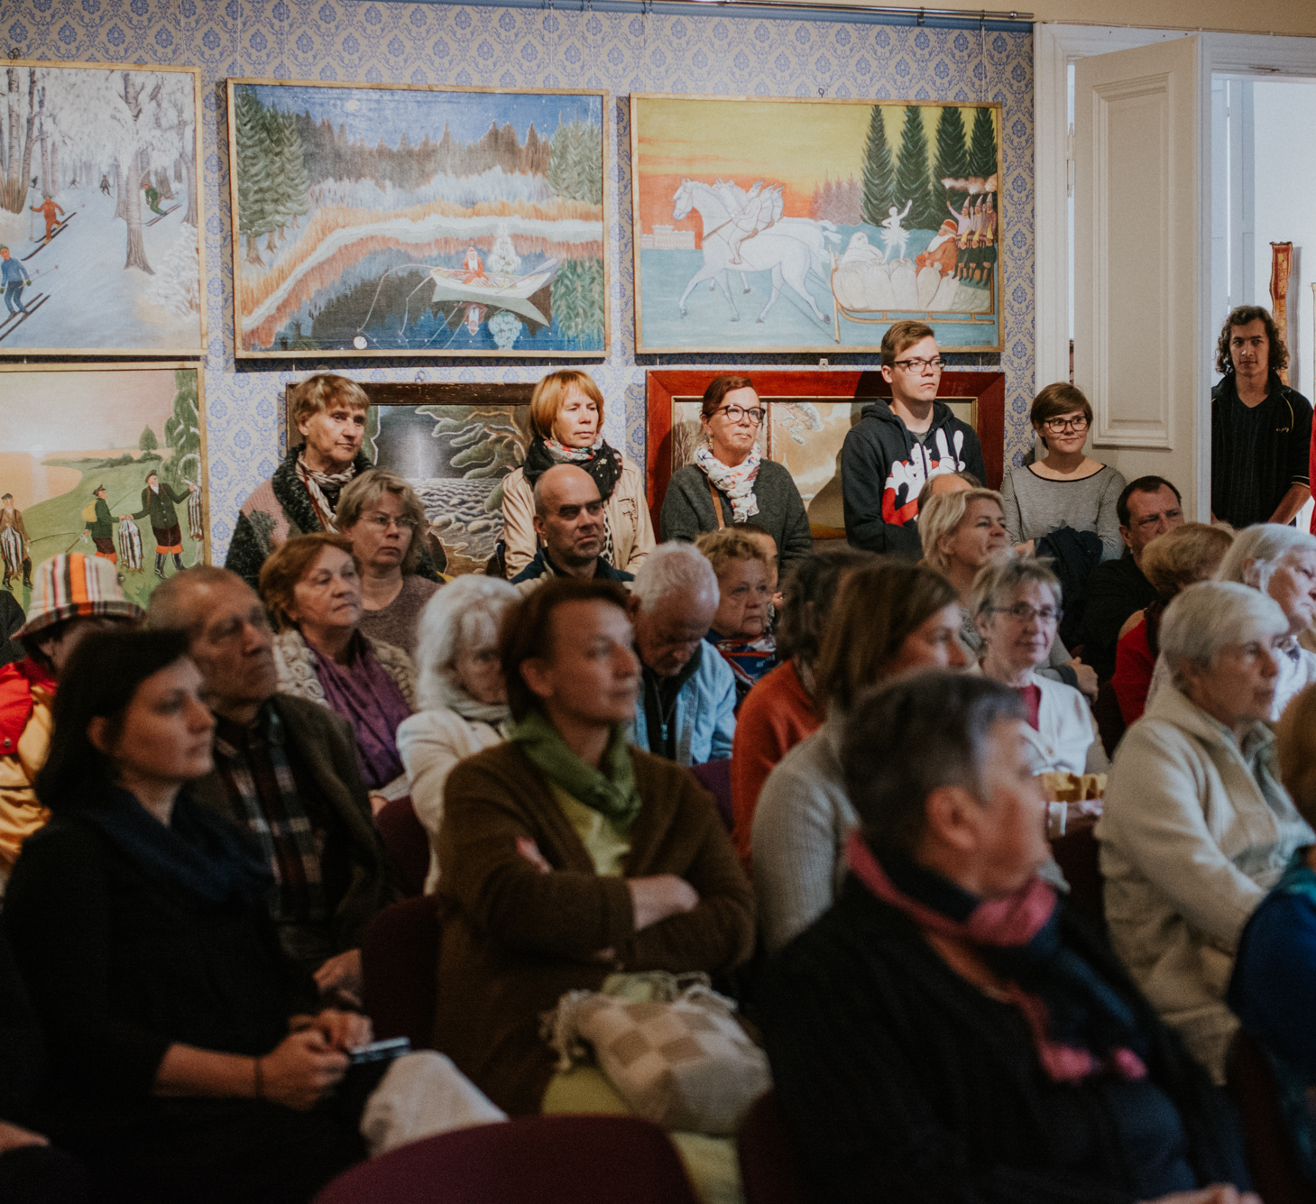
Kondas Centre of Naive Art
Permanent exhibition of Paul Kondas’ works
Outsider art
Art created in carehomes

Slide 22
University of Tartu Viljandi Culture Academy
Professional higher education, BA and MA levels
700+ students
Lifelong learning programmes

Slide 23
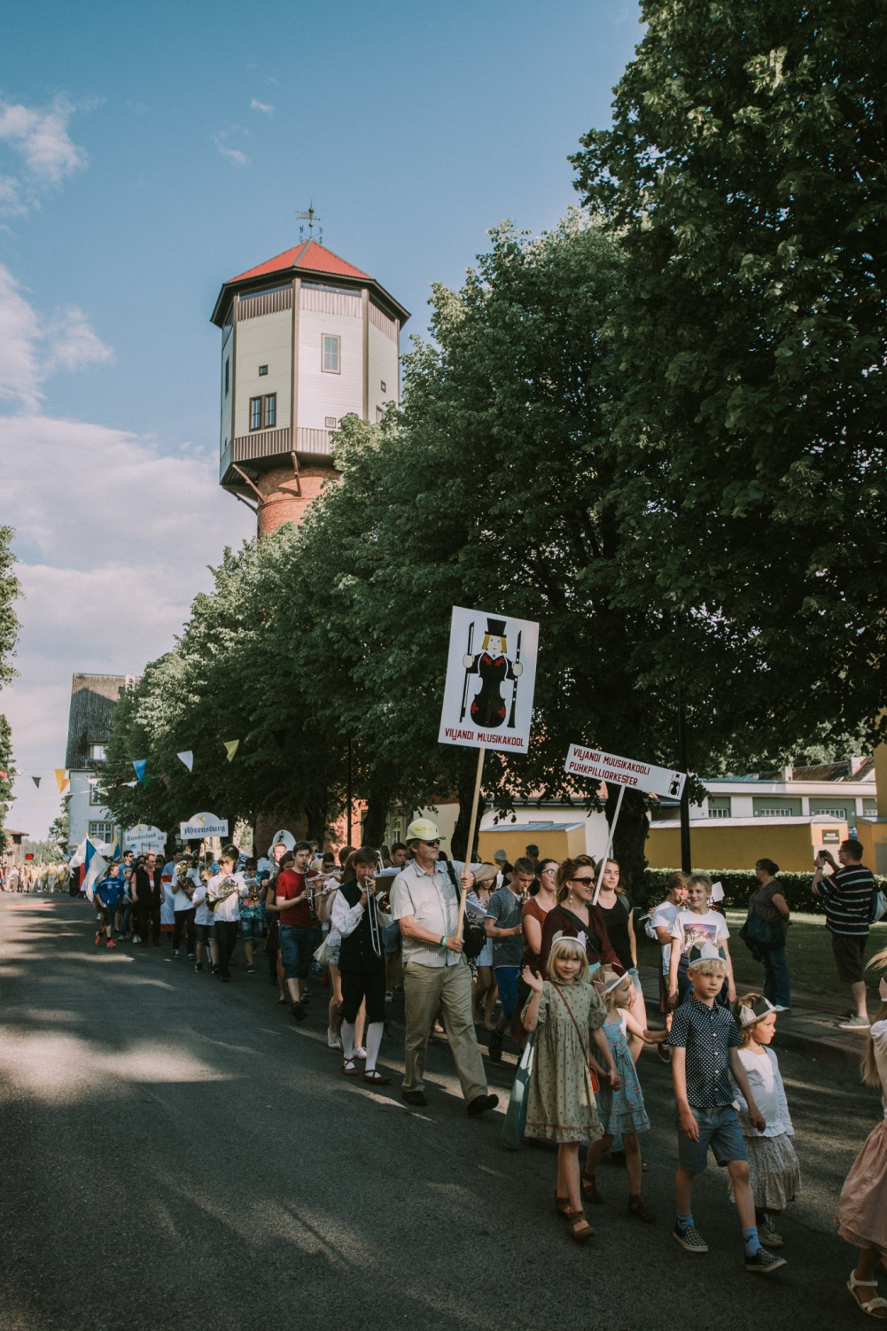
Hanseatic days
7. – 9. June 2019
Cafe Night
County song & dance festival
Over 300 vendors

Slide 24
Viljandi folk music festival
Last weekend of July
Internationally acclaimed festival
30 000+ visitors
More than doubles Viljandi’s population

Slide 25
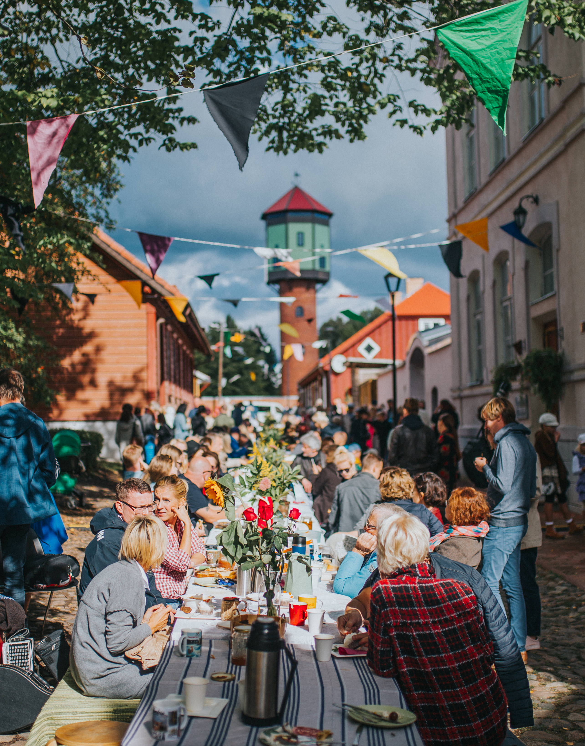
Town birthday celebration
In September every year
Community event
Feeling proud

Slide 26
Other major events
Ice skateing marathon– January
Race around lake Viljandi – 1st May
Comedy festival Wilkom - April
Notafe – beginning of July
Bash – beginning of July
Early Music Festival – mid July
Guitar Festival – mid Octobre

Slide 27
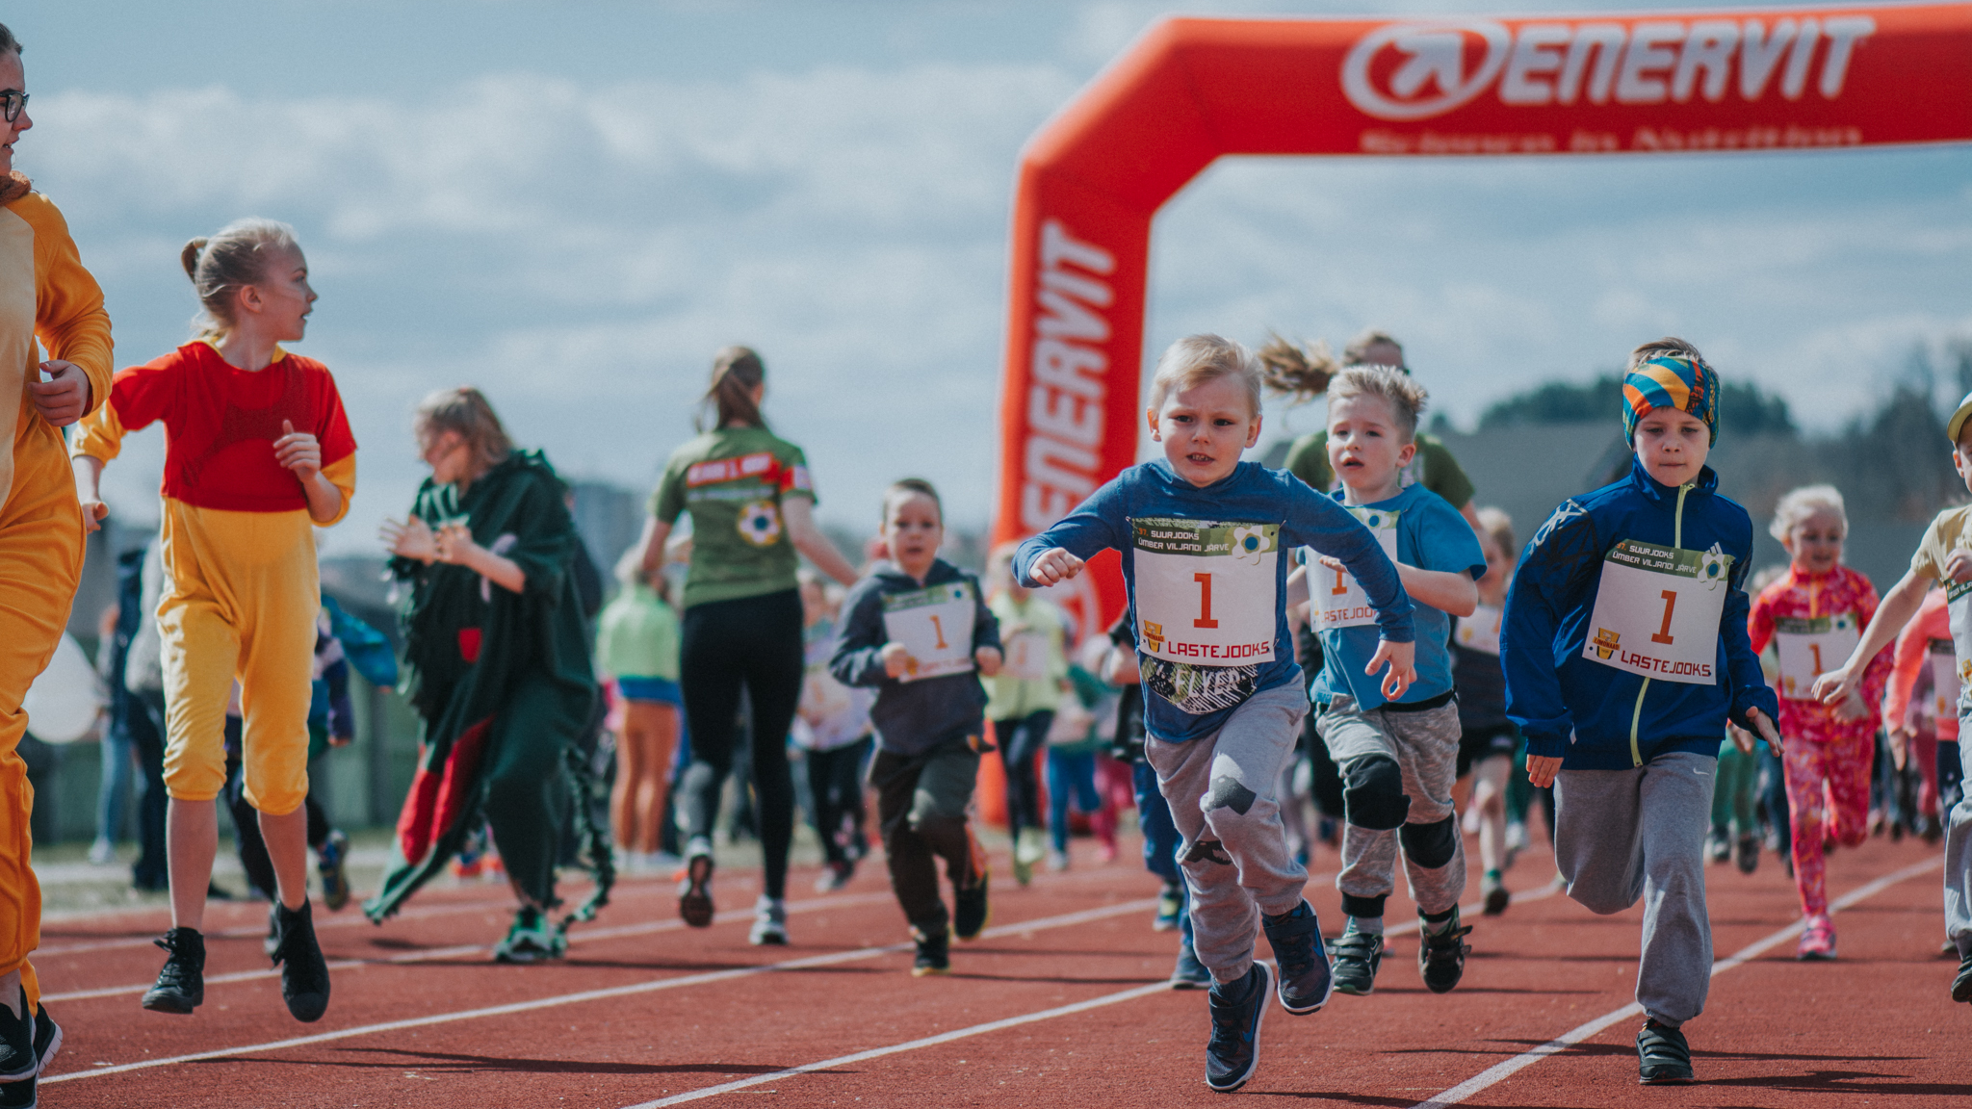
Sports in Viljandi

Slide 28
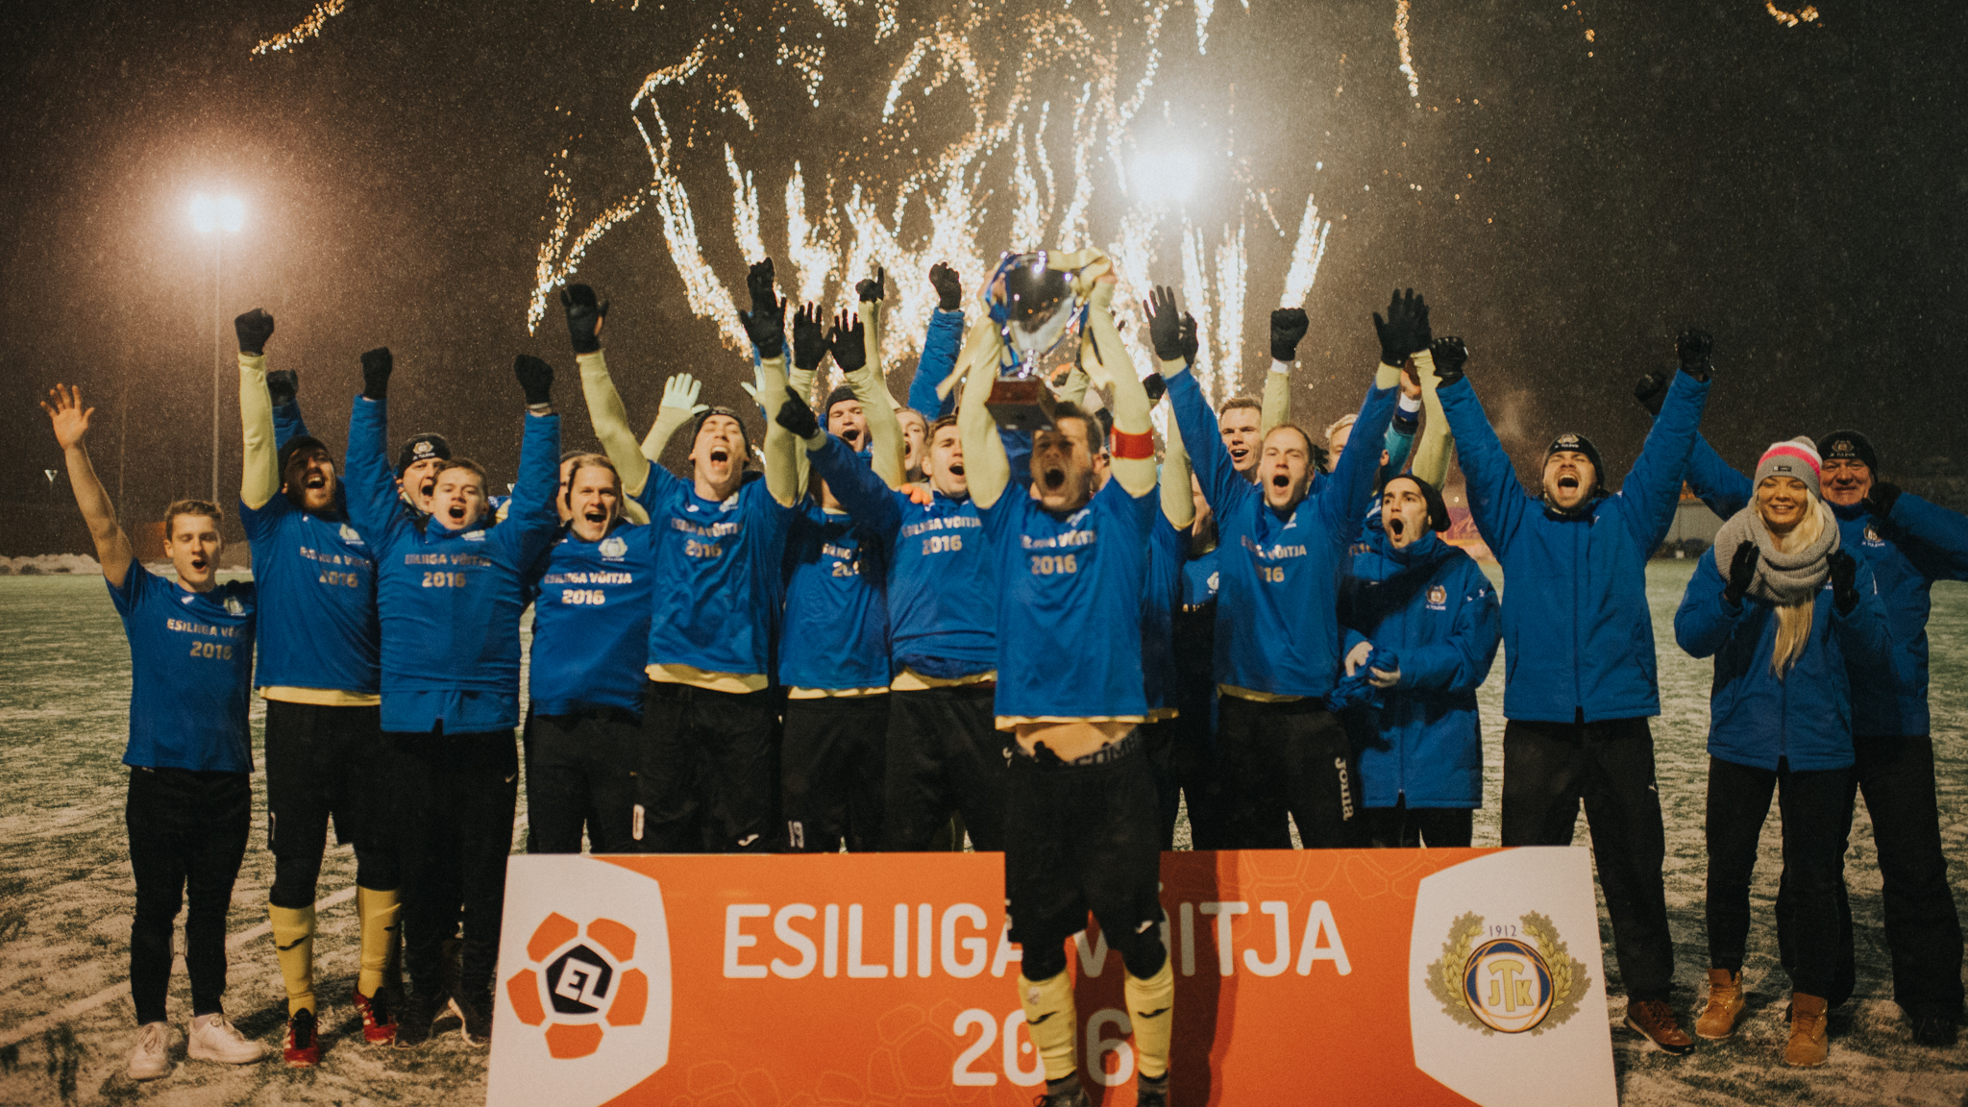
JK Viljandi Tulevik

Slide 29
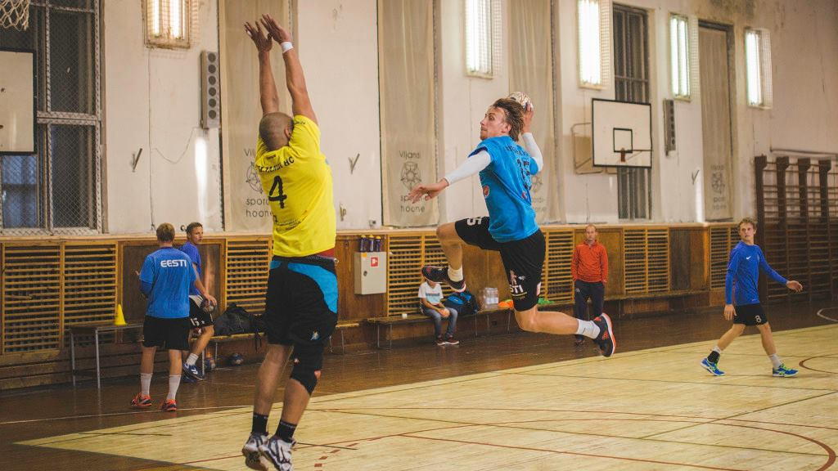
Viljandi HC

Slide 30
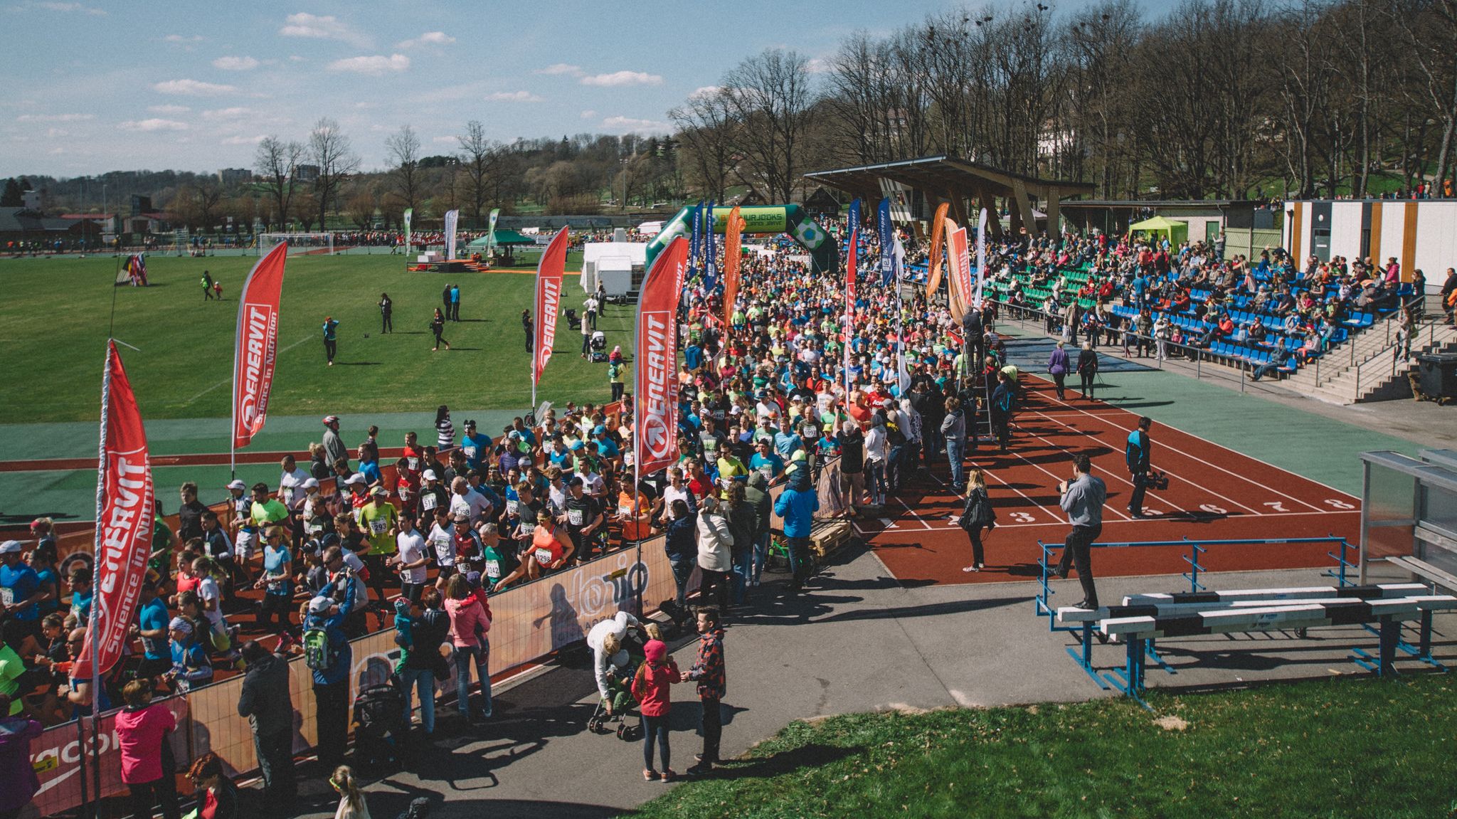
Grand race
around lake Viljandi

Slide 31
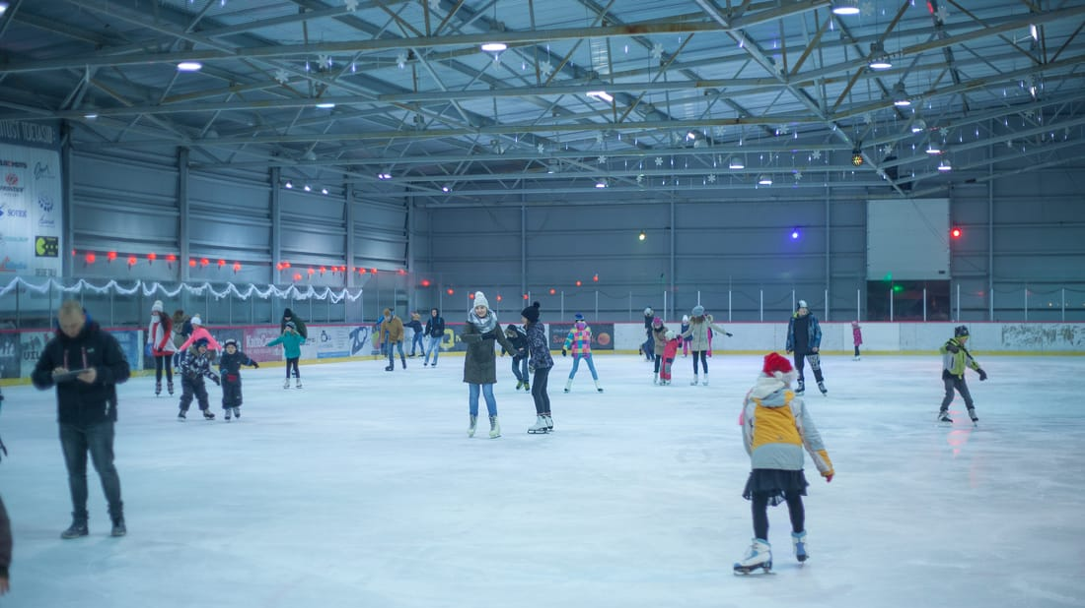
Ice rink

Slide 32
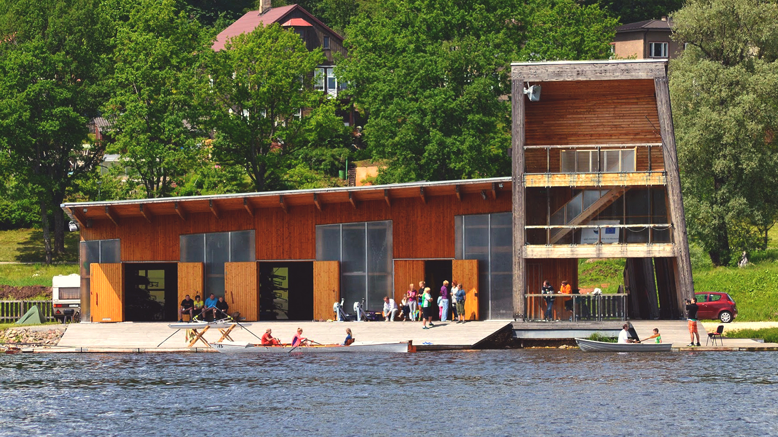
Rowing club

Slide 33
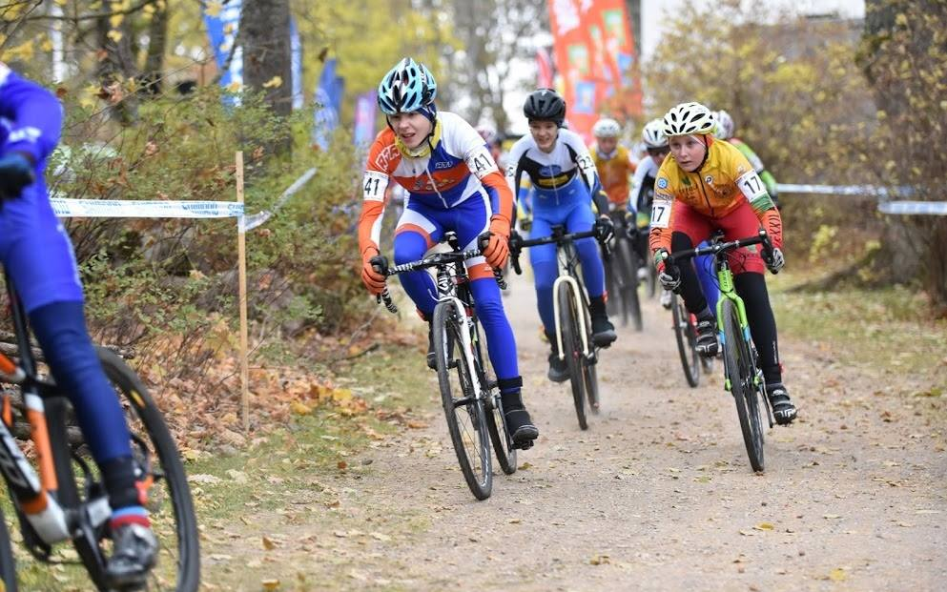
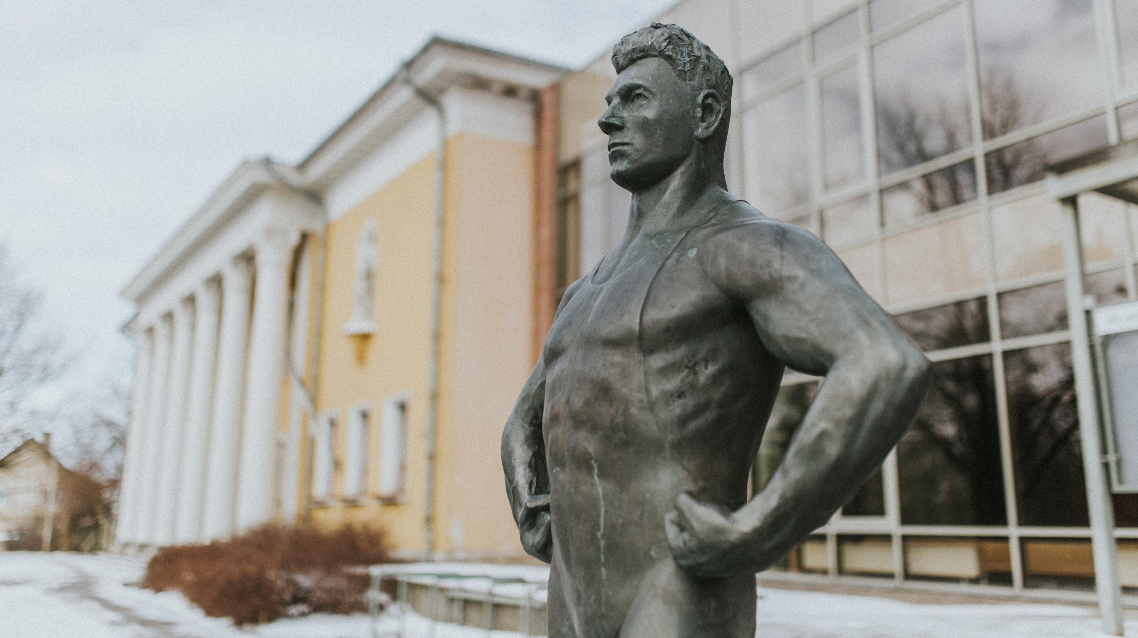
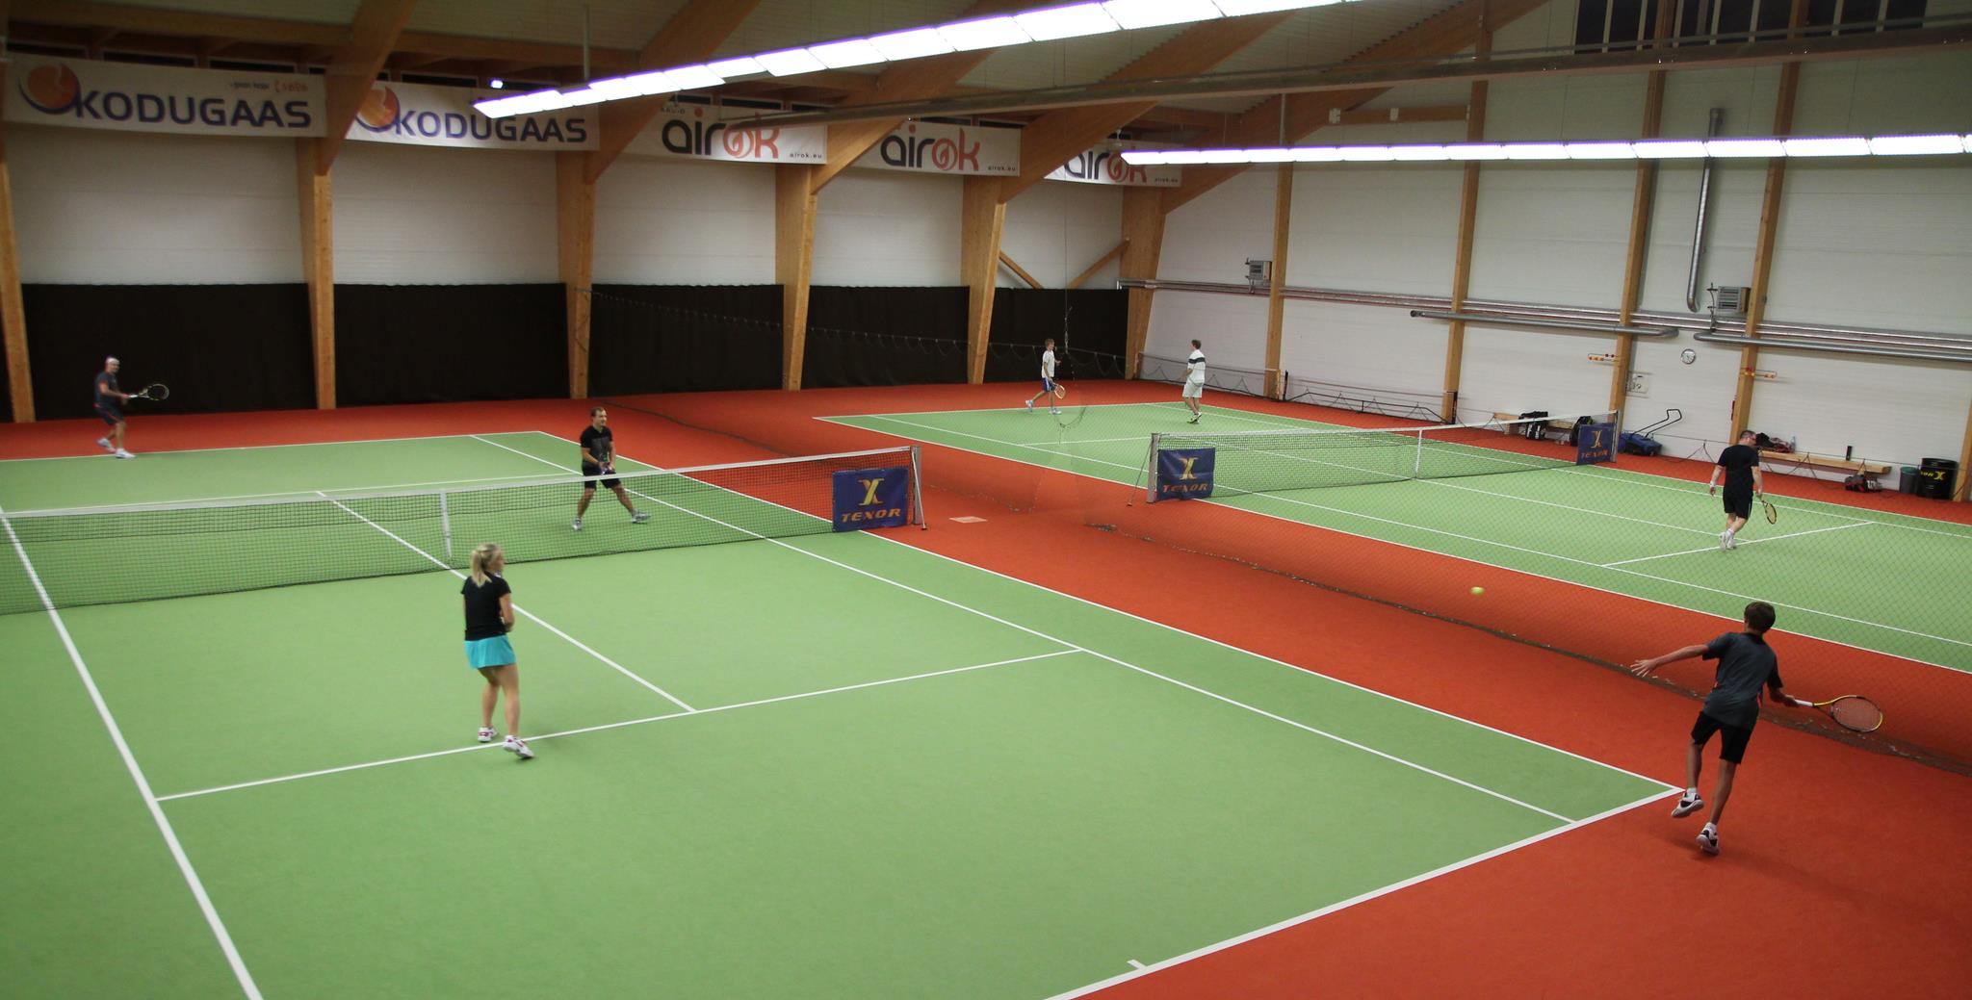
Cycling club
Sports school
Skating marathon
Tennis club

Slide 34
Looking ahead

Slide 35
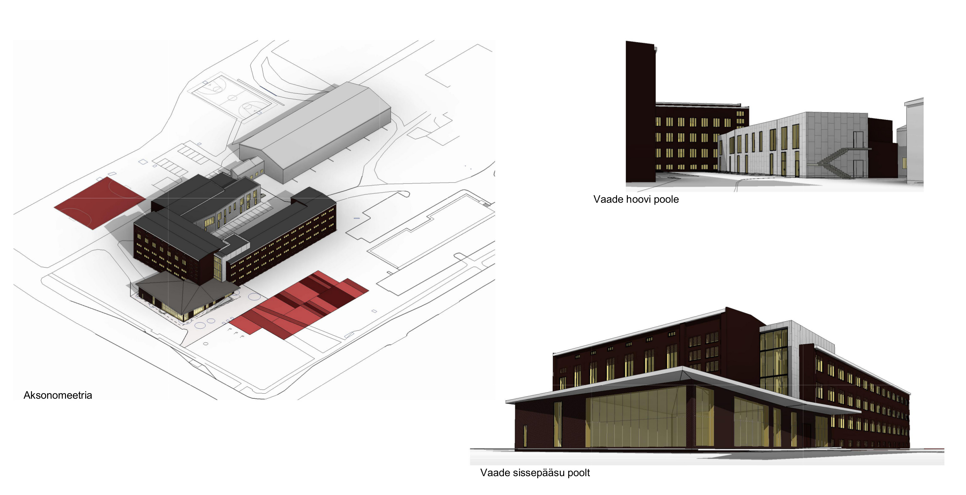
Renovation of
Paalalinna school

Slide 36
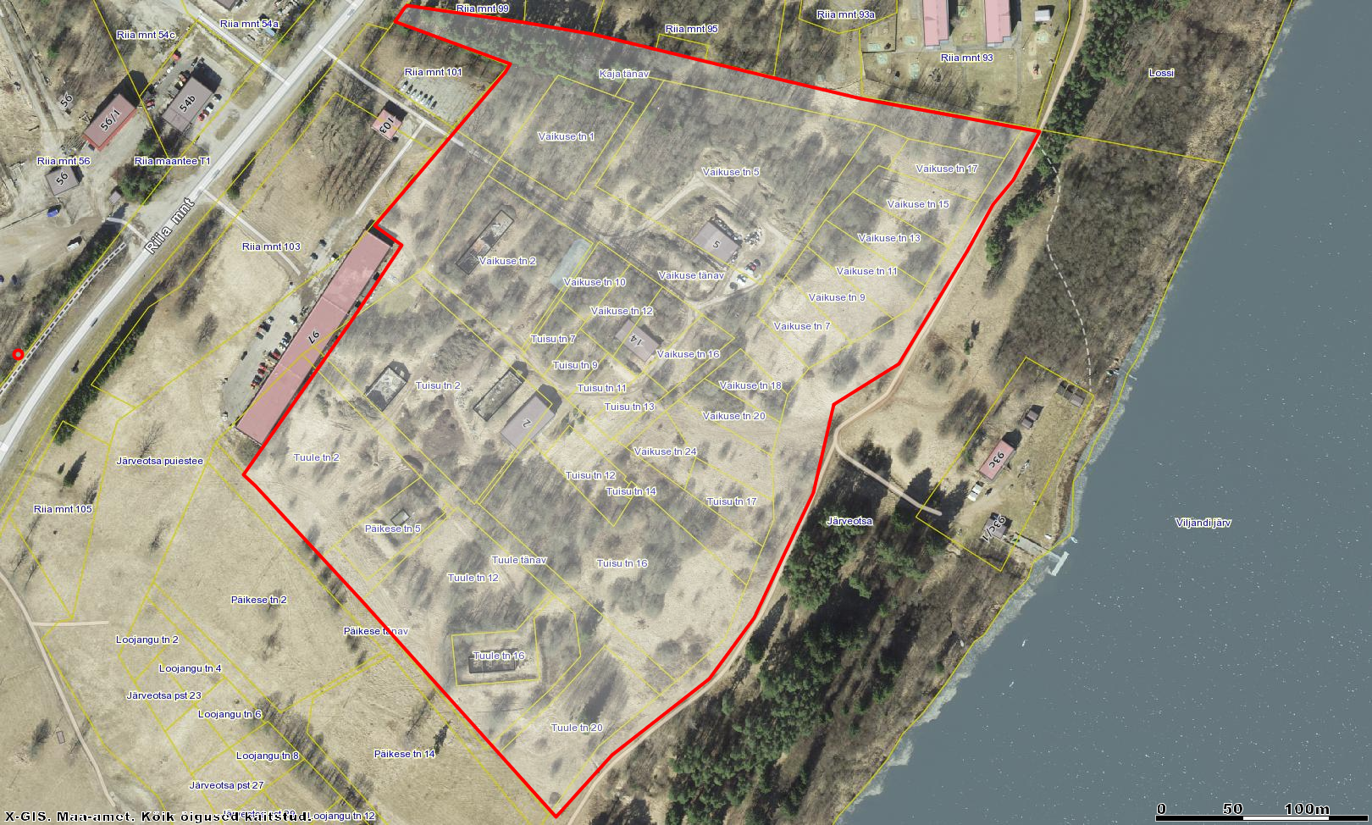
Järveotsa neighbourhood

Slide 37
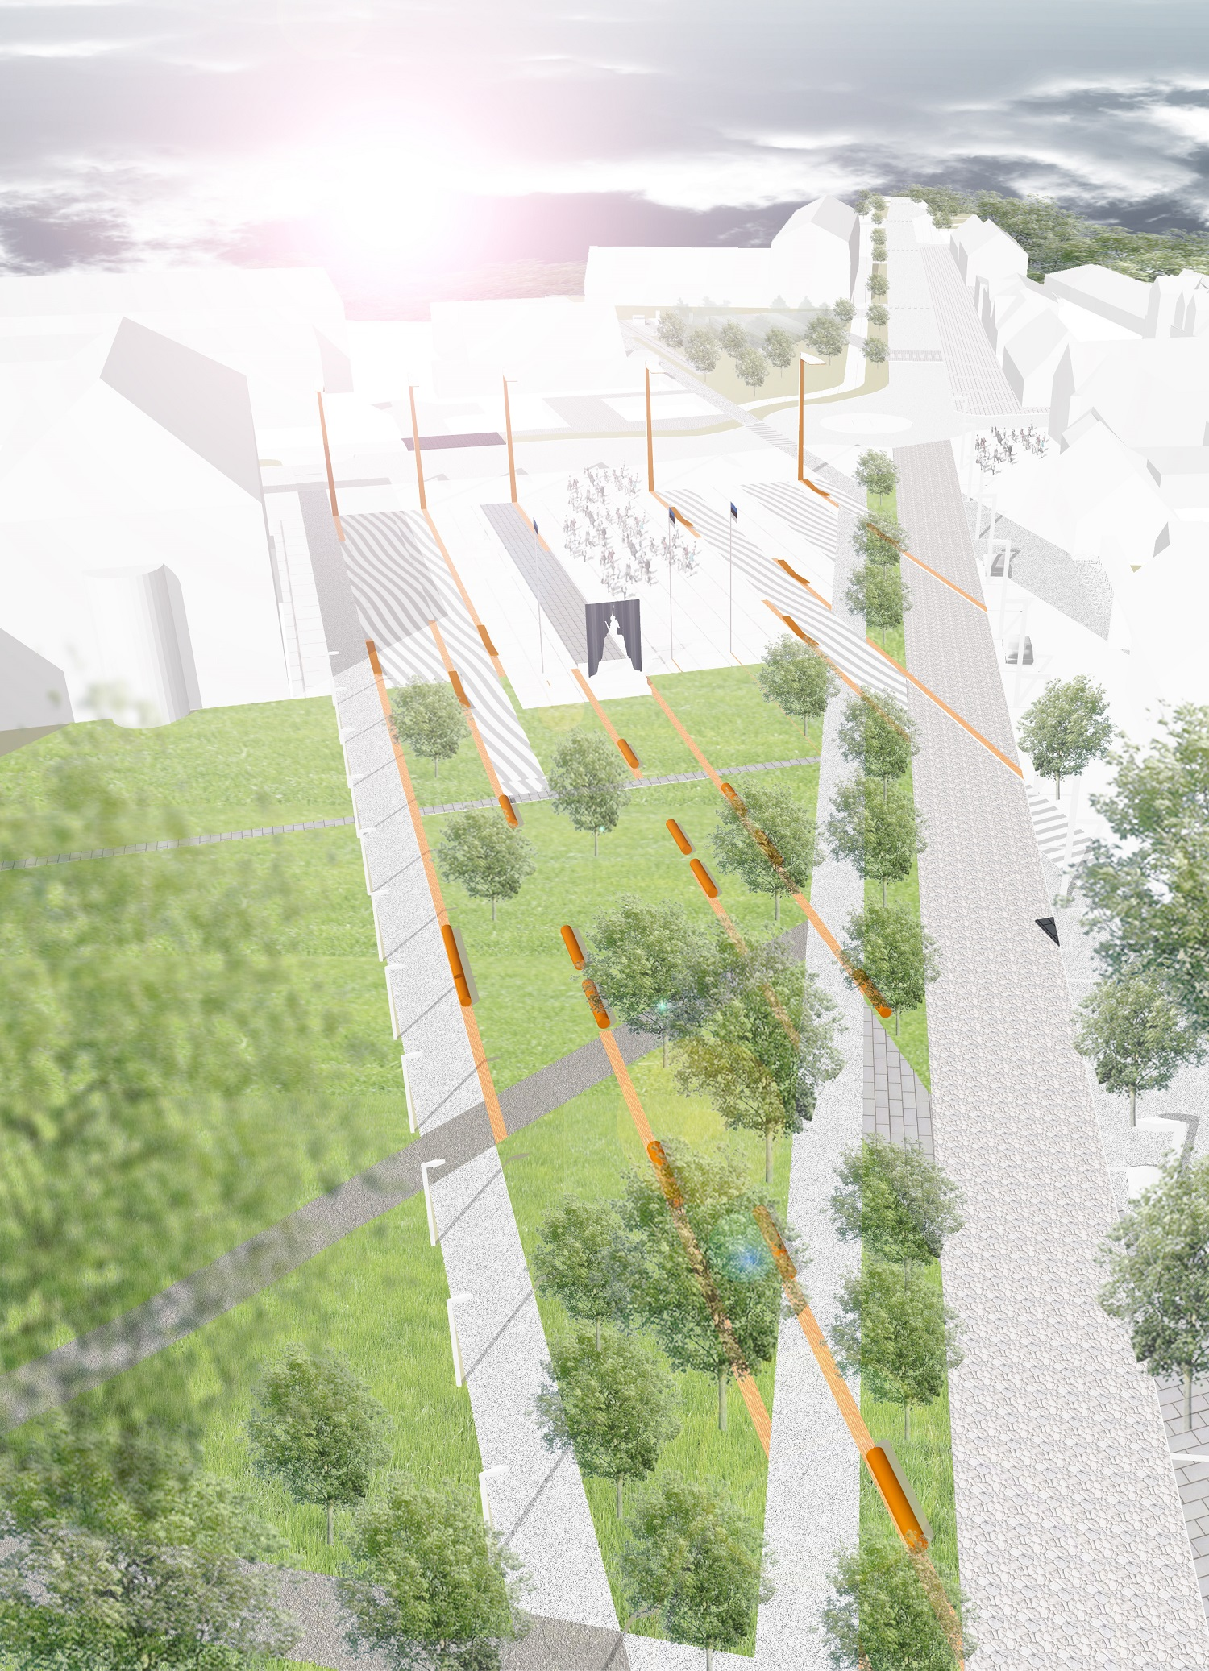
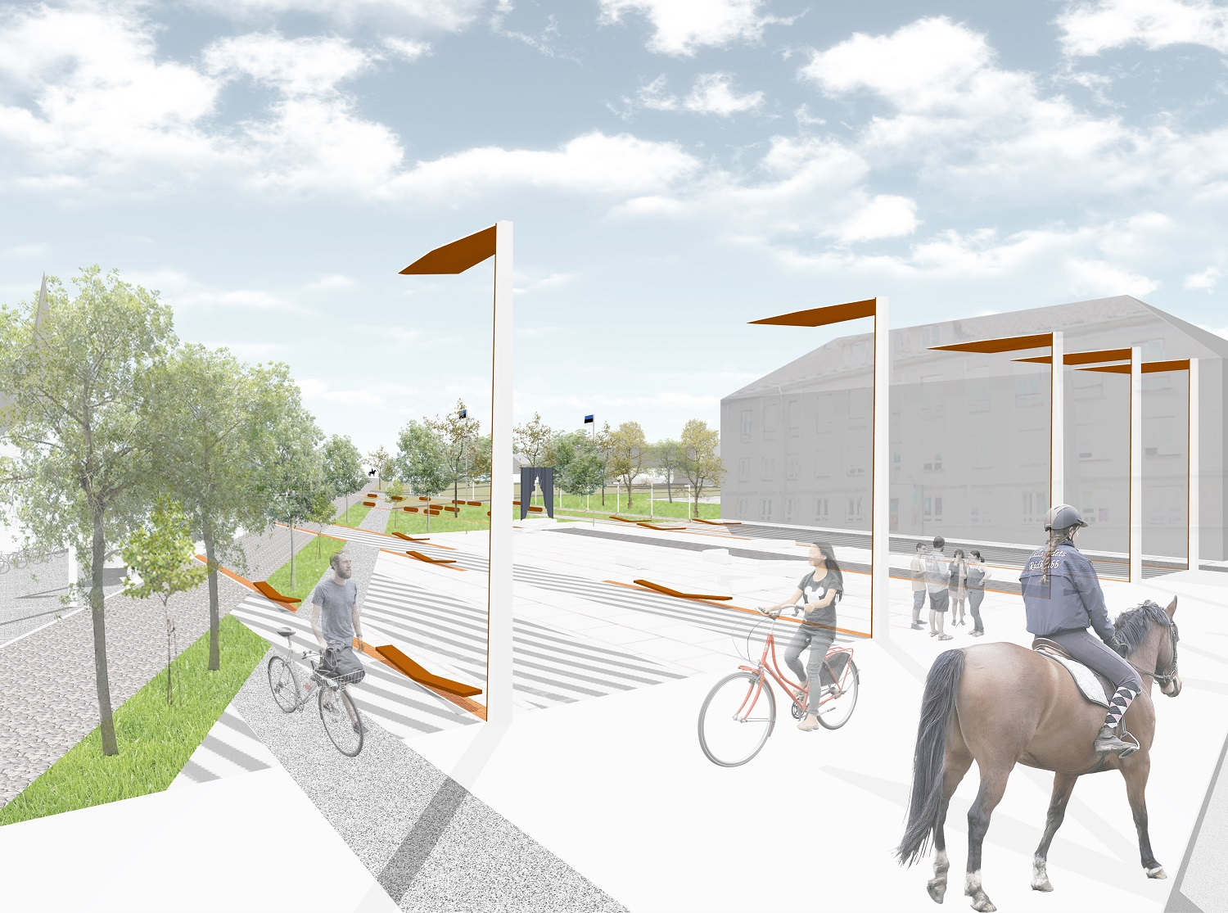
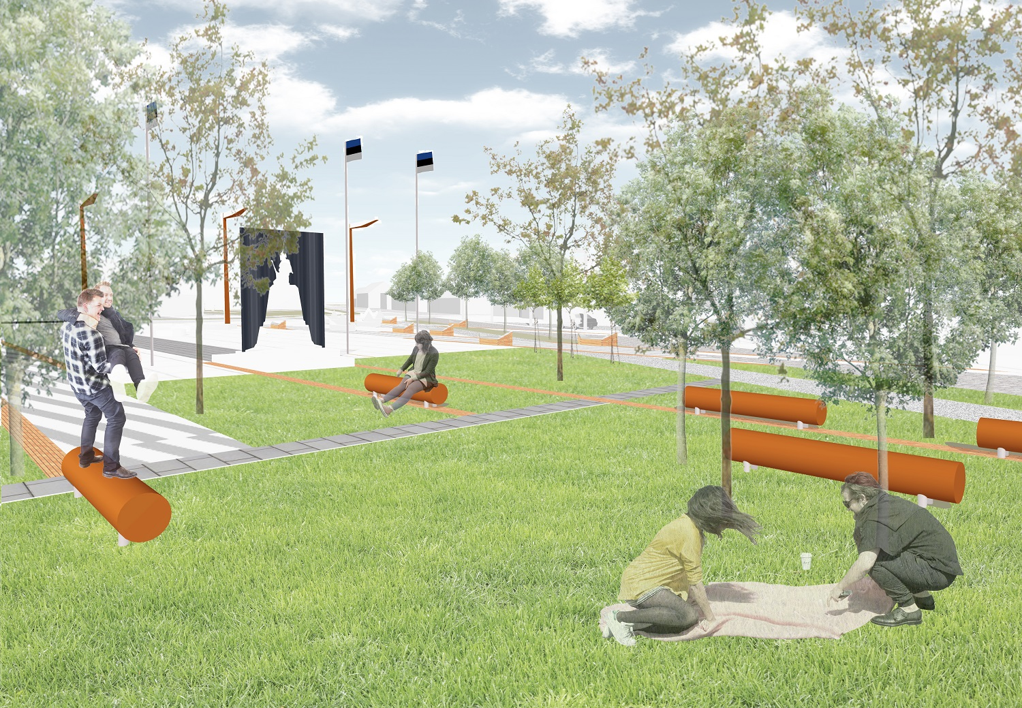
Modernization of town centre

Slide 38
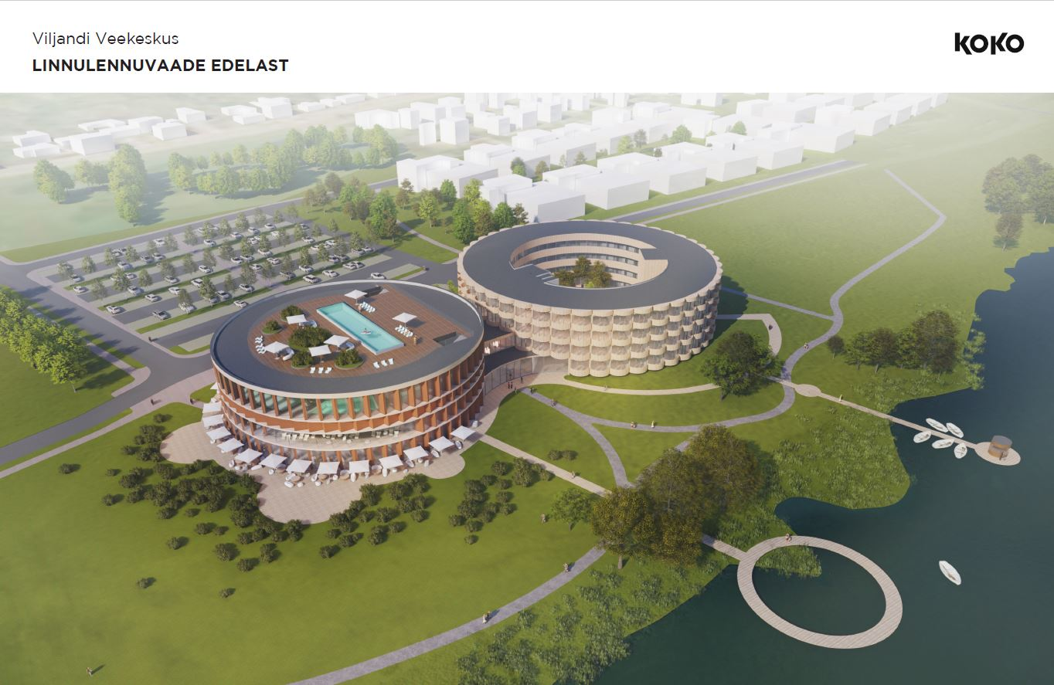
New spa by the lake
developed by private sector

